Slide 1
Modeling the impact of climate change on Indian forest ecosystem with LPJ model
2nd WCRP CORDEX South Asia Workshop, 27-30 August, 2013, Kathmandu
Dr. Rajiv Kumar Chaturvedi National Environmental Sciences Fellow Indian Institute of Science Bangalore

Slide 2
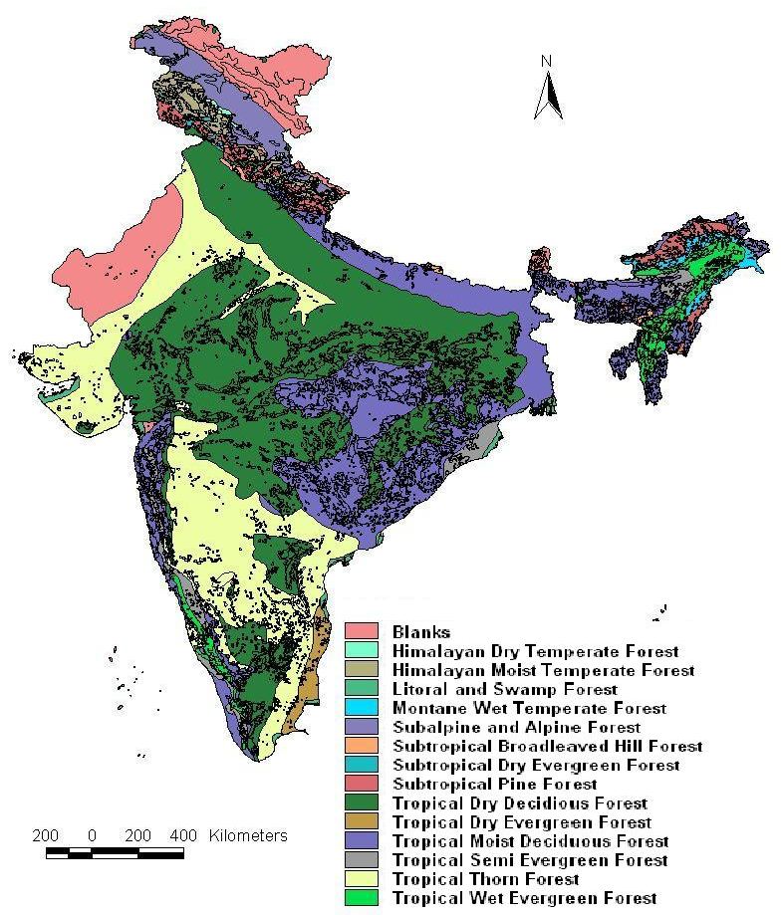
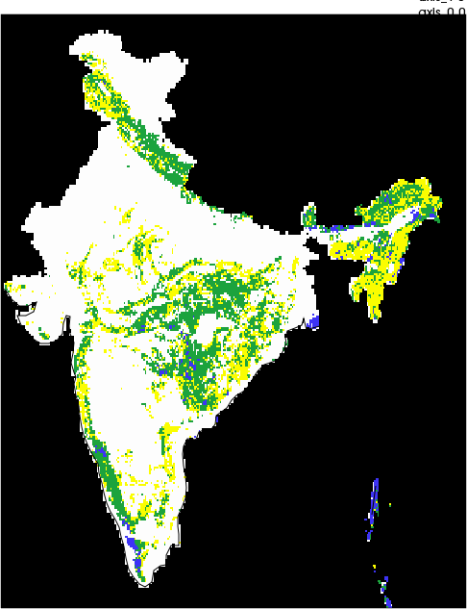
STATE OF INDIAN FORESTS
Source: Champion & Seth, 1968
Source: FSI

Slide 3
Why do we need to study forests?
Stock and sink of carbon
Ecosystem services (e.g. water resources)
Biodiversity
Timber
NTFP production
Livelihoods of forest dependent communities

Slide 4
Key components of Climate Change Impact assessment in the LULUCF sector
Climate models
Climate change scenarios
Vegetation models
Time-steps
Spatial scale
Vulnerability index

Slide 5
Key improvements in climate change impact assessment in the forest sector
Components | What is done so far | What will be new & an improvement
1. Climate models | CMIP3, single model | CMIP5, multi-model
2. Climate Change scenarios | A2, B2, and A1B | RCP 2.6, RCP 4.5, RCP 6.0, and RCP 8.5
3. Vegetation models | BIOME 4, and IBIS, Single DGVM simulation | BIOME4, IBIS, LPJ, Multi-DGVM comparison
4. Time-step | 2030s, and 2080s | Continuous projection from 2005 to 2100 (LPJ); 2030s, 2080s
5. Spatial scale | 0.5°×0.5° | ≥1°×1°
6. Vulnerability Index | Chaturvedi et al 2011, Ravindranath et al 2011 | Improved conceptual framework, and observed data, esp focusing on inherent vuln (Sharma et al 2013)

Slide 6
Tools/Model available for projecting the impacts of climate change on forests
Statistical Models
Deterministic Models
Biogeochemistry Models
Bio-geography Model
Equilibrium/
Static Models
Dynamic Model
Most Advanced tool for impact assessment
(Fishling et al., 2007)

Slide 7
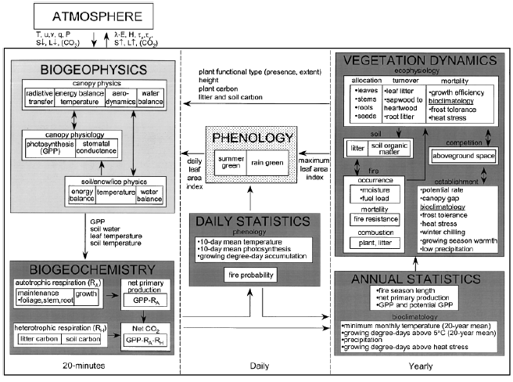
A TYPICAL DGVM ARCHITECTURE

Slide 8
S. N. | Model | ModelingCenter (or Group) | lat – deg | lon – deg
1 | BCC-CSM1-1-M | Beijing Climate Center, China Meteorological Administration | 1.125 | 1.125
2 | CCSM4 | National Center for Atmospheric Research, USA | 0.942 | 1.25
3 | CESM1(CAM5) | Community Earth System Model Contributors | 0.937 | 1.25
4 | GISS-E2-H | NASA Goddard Institute for Space Studies, USA | 1.12 | 1.12
5 | IPSL-CM5A-MR | Institut Pierre-Simon Laplace, France | 1.12 | 1.125
6 | MRI-CGCM3 | Meteorological Research Institute, Japan | 1.132 | 1.125
1 | BCC-CSM1.1 | Beijing Climate Center, China Meteorological Administration | 2.812 | 2.812
2 | CSIRO-Mk3.6 | Commonwealth Scientific and Industrial Research Organization in collaboration with Queensland Climate Change Centre of Excellence, Australia | 1.895 | 1.875
3 | FIO-ESM | The First Institute of Oceanography, SOA, China | 2.812 | 2.812
4 | GFDL-CM3 | NOAA Geophysical Fluid Dynamics Laboratory | 2 | 2.5
5 | GFDL-ESM2G | NOAA Geophysical Fluid Dynamics Laboratory | 2 | 2.5
6 | GFDL-ESM2M | NOAA Geophysical Fluid Dynamics Laboratory | 2 | 2.5
7 | GISS-E2-R | NASA Goddard Institute for Space Studies, USA | 2.022 | 2.517
8 | HadGEM2-AO | Met Office Hadley Centre, UK | 1.241 | 1.875
9 | HadGEM2-ES | Met Office Hadley Centre, UK | 1.25 | 1.875
10 | IPSL-CM5A-LR | Institut Pierre-Simon Laplace, France | 1.895 | 3.75
11 | MIROC5 | The University of Tokyo | 1.417 | 1.406
12 | MIROC-ESM | The University of Tokyo | 2.857 | 2.813
13 | MIROC-ESM-CHEM | The University of Tokyo | 2.857 | 2.813
14 | NorESM1-M | Norwegian Climate Centre | 1.895 | 2.5
15 | NorESM1-ME | Norwegian Climate Centre | 1.875 | 2.5

Slide 9
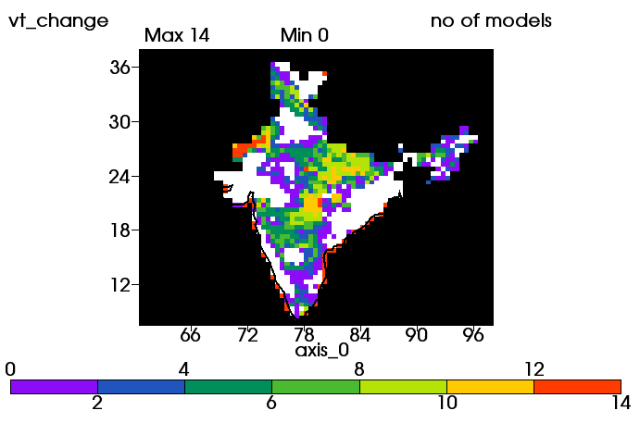
LPJ results from an ensemble of 14 Climate models

Slide 10
Modeling demonstration for hands-on training
1 | BCC-CSM1.1 | Beijing Climate Center, China Meteorological Administration | 2.812 | 2.812
Input data: Mean monthly temperature; Mean monthly precipitation and Cloudiness
Outputs: Dominant vegetation; NPP; Soil carbon; Vegetation carbon etc

Slide 11
Thanks

